Slide 1
AI-Based Phishing Detection
Presented By, | Under the guidance of, Guide Name Designation Department of CSE, EPCET
Name(USN)
Name(USN)
Name(USN)
Name(USN)

Slide 2
Introduction
Domain Overview: Artificial Intelligence (AI) and Cybersecurity are critical domains in combating digital threats. Machine Learning (ML) has emerged as a potent tool for analyzing patterns and detecting anomalies in digital communications.
Project Topic Introduction: Phishing attacks exploit human vulnerabilities through deceptive emails and URLs, compromising sensitive information. This project aims to develop a phishing detection system using ML techniques to safeguard against these attacks.

Slide 3
Problem Statement
Phishing remains one of the most significant cybersecurity challenges, causing data breaches and financial losses. Current detection methods struggle with real-time analysis and generalizing to new phishing techniques. This project addresses these gaps by building an ML-based system for detecting phishing in emails and URLs.

Slide 4
Literature Survey
Author(s) | Year | Title | Methodology | Findings
Aburrous et al. | 2010 | Phishing website detection | Neural networks | Achieved 86% accuracy in URL-based phishing detection
Verma & Hossain | 2017 | Detecting phishing emails using NLP | Logistic regression with NLP | Analyzed email content for phishing indicators
Aprilia et al. | 2020 | Phishing detection using machine learning | SVM, Decision Trees | Found SVM to be effective for identifying phishing emails
Huang et al. | 2022 | Real-time URL phishing detection | Ensemble learning (XGBoost, RF) | Achieved high accuracy with reduced false positives

Slide 5
Existing System
Description: Current systems use rule-based approaches or predefined heuristics to identify phishing attempts.
Limitations:
High false positive rates.
Poor generalization to new phishing techniques.
Inability to process data in real-time.

Slide 6
Proposed System
Description: A machine learning model trained on email and URL datasets to identify phishing attacks. Deployed via Flask for real-time accessibility.
Advantages:
Adaptable to evolving phishing techniques.
Faster and more accurate detection.
Seamless integration into web applications.

Slide 7
Aim of the Project
The primary aim of the project is to build an intelligent, real-time phishing detection system that leverages machine learning to analyze emails and URLs. By integrating this system into a user-friendly web application, we seek to:
Detect phishing attempts with high accuracy, reducing financial and personal data theft.
Provide a scalable and robust solution that adapts to evolving phishing tactics.
Enhance cybersecurity measures in organizations by seamlessly integrating the detection mechanism into their existing infrastructure.
Ensure quick and reliable classification of email and URL legitimacy, thus improving user confidence and trust in digital communication systems.

Slide 8
Objectives
Objectives
Collect and preprocess datasets of phishing and legitimate emails/URLs.
Train and evaluate a machine learning model for phishing detection.
Build a Flask-based web application for real-time deployment.
Ensure scalability and accuracy in varying environments

Slide 9
System Architecture
Start
Input Email/URL
Flowchart:
Input Layer: Email/URL as input.
Preprocessing: Feature extraction using NLP and URL parsing.
Classification: ML model prediction (phishing or legitimate).
Output: Display result and log details.
Feature Extraction
Preprocessing
Machine Learning Model
Classification
Output Result

Slide 10
System Design
Level 0 DFD
User inputs email/URL into the system.
System preprocesses input data.
ML model processes and classifies data.
Results are sent back to the user.
Level 1 DFD
Preprocessing Module: Tokenizes and cleans text data.
Feature Extraction Module: Extracts syntactic, semantic, and domain-based features.
Classification Module: Predicts phishing or legitimate.
Feedback Module: Provides the result with a confidence score

Slide 11
System Modules
ER Diagram
Entities and relationships:
Dataset: Contains records of emails/URLs with features.
Features: Associated with dataset for preprocessing and ML training.
Model: Uses the dataset for training and outputs predictions.
User: Inputs data and receives classification results.

Slide 12
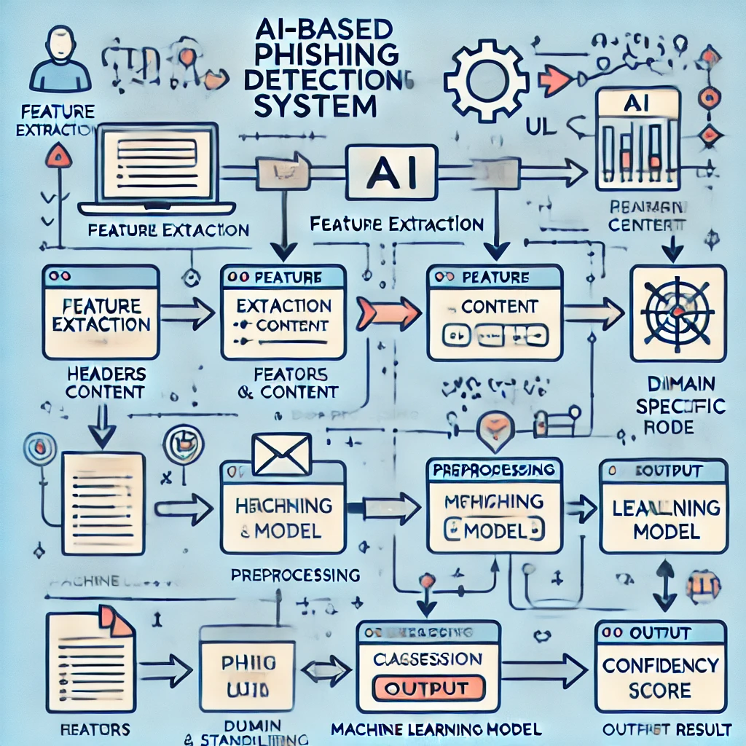

Slide 13
Input and Output
Input: Raw email content, URLs.
Output: Phishing or legitimate classification, confidence score

Slide 14
Hardware and Software Requirements
Hardware:
Intel i5 processor or higher.
8GB RAM.
SSD for fast data processing.
Software:
Python (scikit-learn, Flask, TensorFlow/Keras).
Dataset sources (PhishTank, Kaggle).
Justification: Python's libraries offer robust support for ML, Flask ensures easy deployment, and the chosen hardware supports real-time processing.

Slide 15
Implementation Plan
Month | Task | Deliverable
Month 1 (Nov) | Literature review, dataset collection | Dataset, Literature Survey document
Month 2 (Dec) | Model training and evaluation | ML model
Month 2 (Dec) | Flask integration | Web application
Month 3 (Jan) | Testing and optimization | Final project

Slide 16
Publication Plan
Target conference:
IEEE International Symposium on Security and Privacy

Slide 17
Conclusion
The "AI-Based Phishing Detection" system is a step toward ensuring cybersecurity in an increasingly digital world. By combining machine learning's predictive power with real-time deployment through Flask, this system provides a robust, scalable, and efficient solution to detect phishing attacks. The system not only enhances protection against evolving phishing techniques but also ensures adaptability for future improvements, making it an indispensable tool for organizations and individuals alike.
Future work can focus on expanding its scope to detect phishing attempts in social media links and mobile platforms, further reinforcing digital safety.

Slide 18
References
[1] Alnemari Shouq, Alshammari Majid (2023) “Detecting Phishing Domains Using Machine Learning,” Applied Sciences, 13(8), pp. 4649.This study explores the efficiency of machine learning models like Random Forests, Decision Trees, SVMs, and ANNs in detecting phishing domains using the UCI phishing domains dataset. Random Forest outperformed other models in accuracy. DOI: 10.3390/app13084649.
[2] Thakur Kutub, Ali Md Liakat, Obaidat Muath A., Kamruzzaman Abu (2023) “A Systematic Review on Deep-Learning-Based Phishing Email Detection,” Electronics, 12(21), pp. 4545.This paper reviews the application of CNNs and LSTMs in detecting phishing emails and their effectiveness in identifying sophisticated attacks, highlighting the strengths and challenges of deep learning in this domain. DOI: 10.3390/electronics12214545.
[3] Kapan Sibel, Gunal Efnan Sora (2023) “Improved Phishing Attack Detection with Machine Learning: A Comprehensive Evaluation of Classifiers and Features,” Applied Sciences, 13(24), pp. 13269.This research analyzed the contributions of various features and classifiers for detecting phishing websites. It revealed that decision trees provided high accuracy (F1-score of 0.99) using URL and HTTP features from a novel phishing dataset. DOI: 10.3390/app132413269.
[4] Alzahrani Abdullah I. A. (2023) “A Deep Learning-Based Innovative Technique for Phishing Detection in Modern Security with Uniform Resource Locators,” Sensors, 23(9), pp. 4403.This study introduced a CNN-based model for detecting phishing URLs with an accuracy of 98.77%. The Phish Tank dataset was extensively used, demonstrating the model's superiority in URL-based phishing detection. DOI: 10.3390/s23094403.

